Slide 1
Connect Anypoint to ActiveMQ 2019
Geert Vegter g.j.vegter@pl.hanze.nl

Slide 2
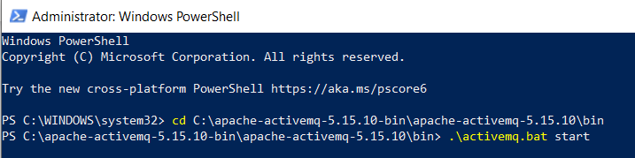
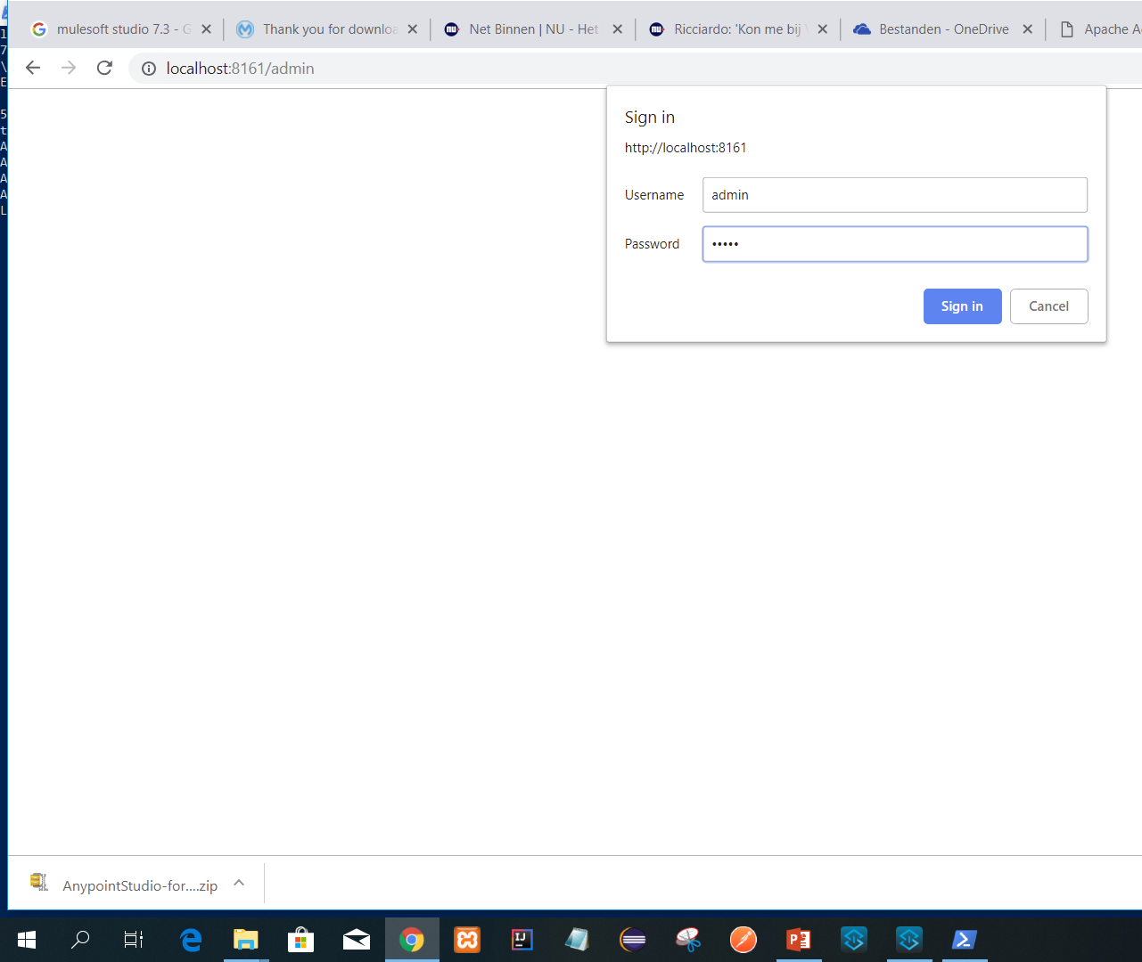
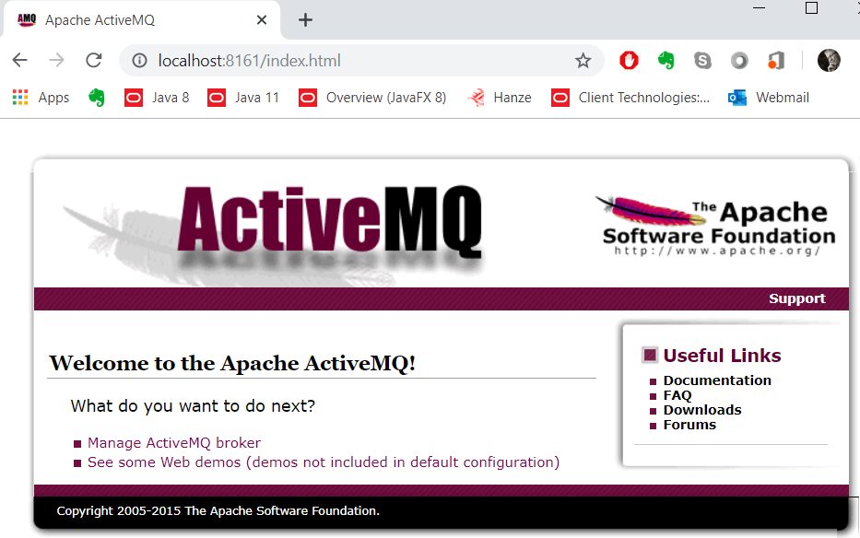
Make sure ActiveMQ is started well, so the admin panel is visible
admin
admin

Slide 3
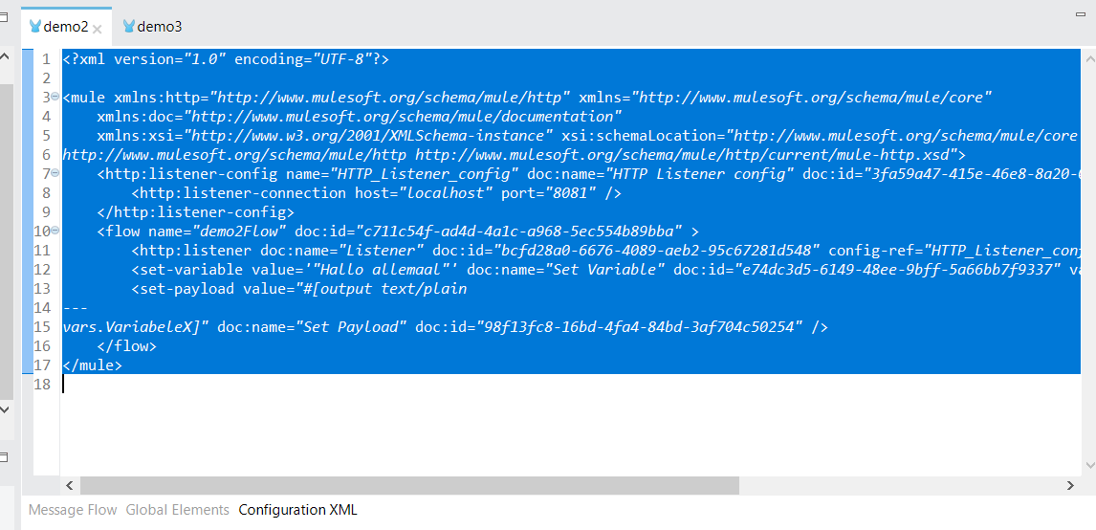
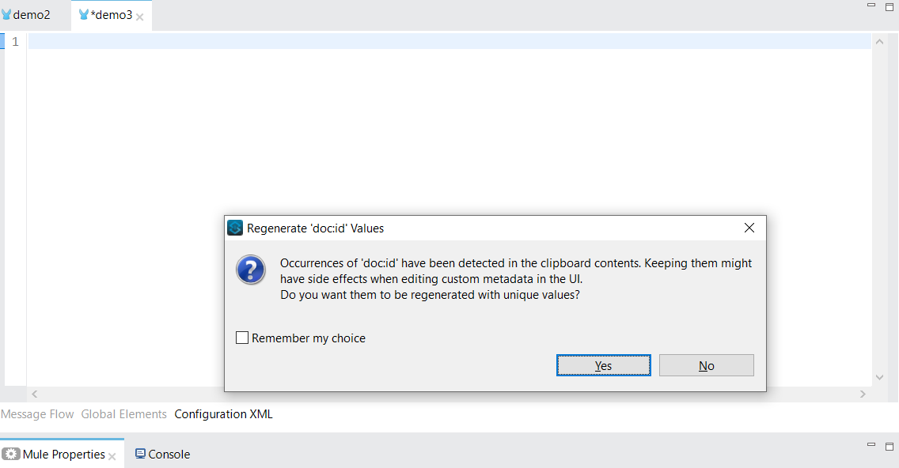
You can copy learning task1 XML definition to paste in a new flow.
Say YES !

Slide 4
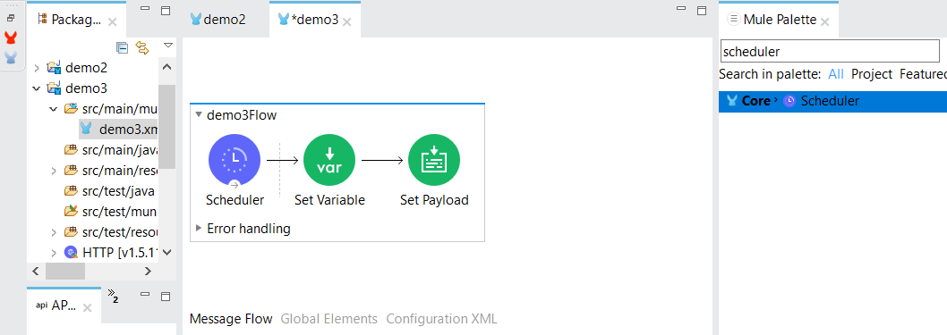
You may start a flow by using the http-listener which was defined in learning task 1. Below the flow is started with a scheduler:
This was done by dragging the Scheduler component above the previous flow and then move the to green components to it. Then delete the remaining part of the previous flow.

Slide 5
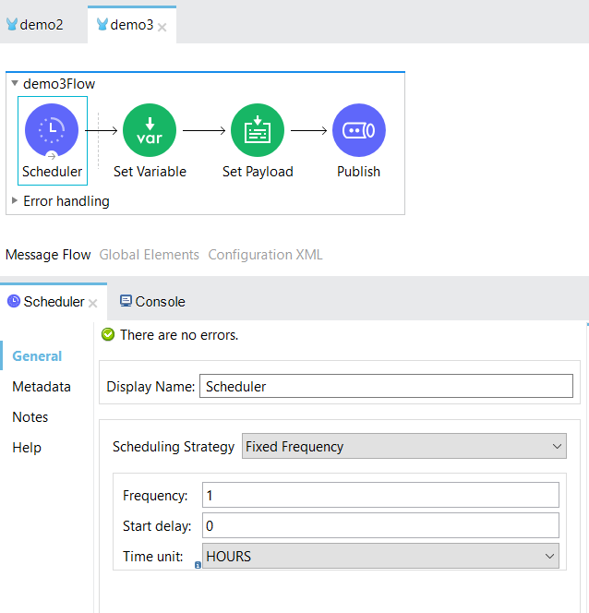
Set frequency = 1 , Time unit = HOURS

Slide 6
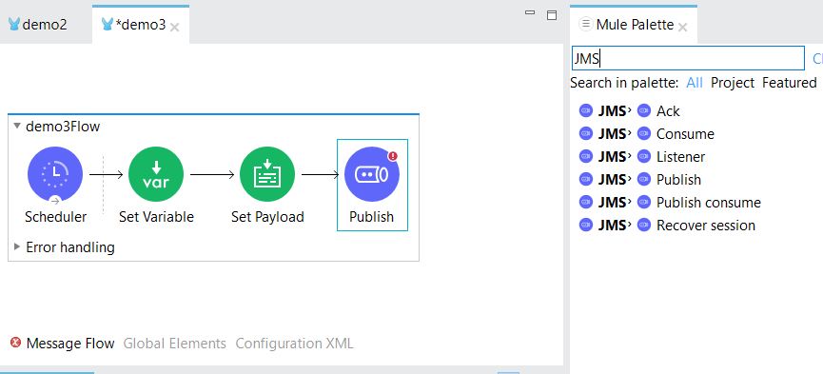
Search for JMS components in the Mule Palette and add JMS Publish to the flow

Slide 7
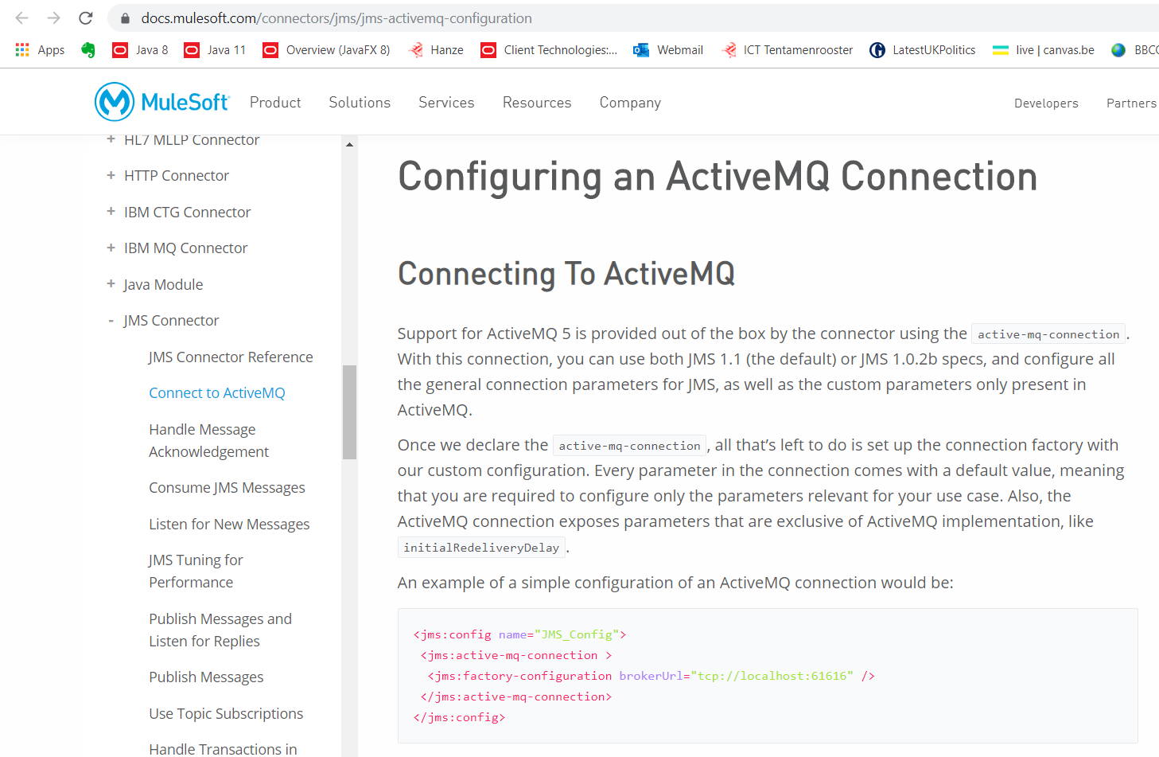
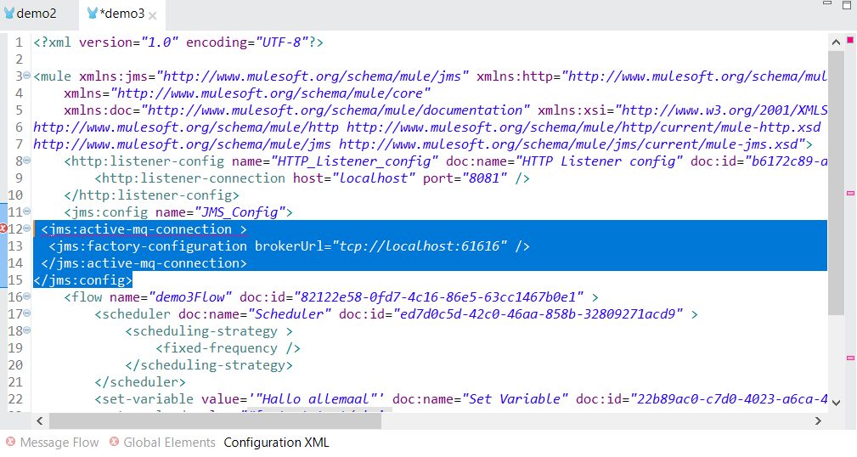
Go to this site: https://docs.mulesoft.com/connectors/jms/jms-activemq-configuration and copy the code to paste it in the Configuration XML of your current flow.

Slide 8
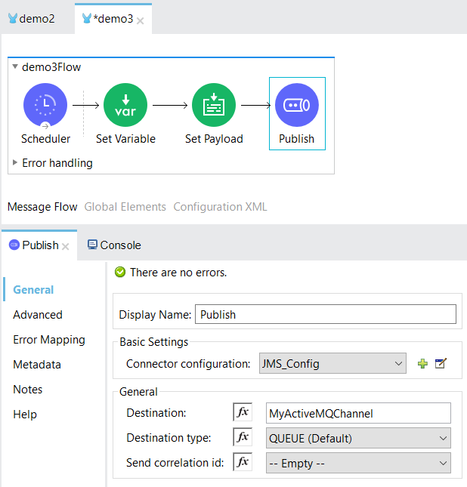
Now go to the Message Flow and set the name of the Destination in the Publish component. This name will show up in ActiveMQ as a QUEUE or a TOPIC, depending on the Destination type you set. Also refer to the JMS_CONFIG definition you just made.

Slide 9

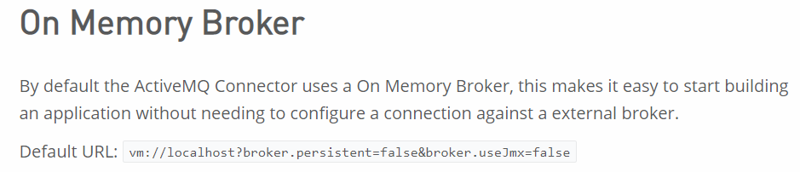
Now we can have this issue that you configured the internal JMS message broker of Anypoint on the virtual machine in stead of the external ActiveMQ. (depending on how you have configured the JMS Config):
But here it seems to be OK. (see next slide)
Correct configuration
Wrong configuration
ActiveMQ is an external message broker

Slide 10
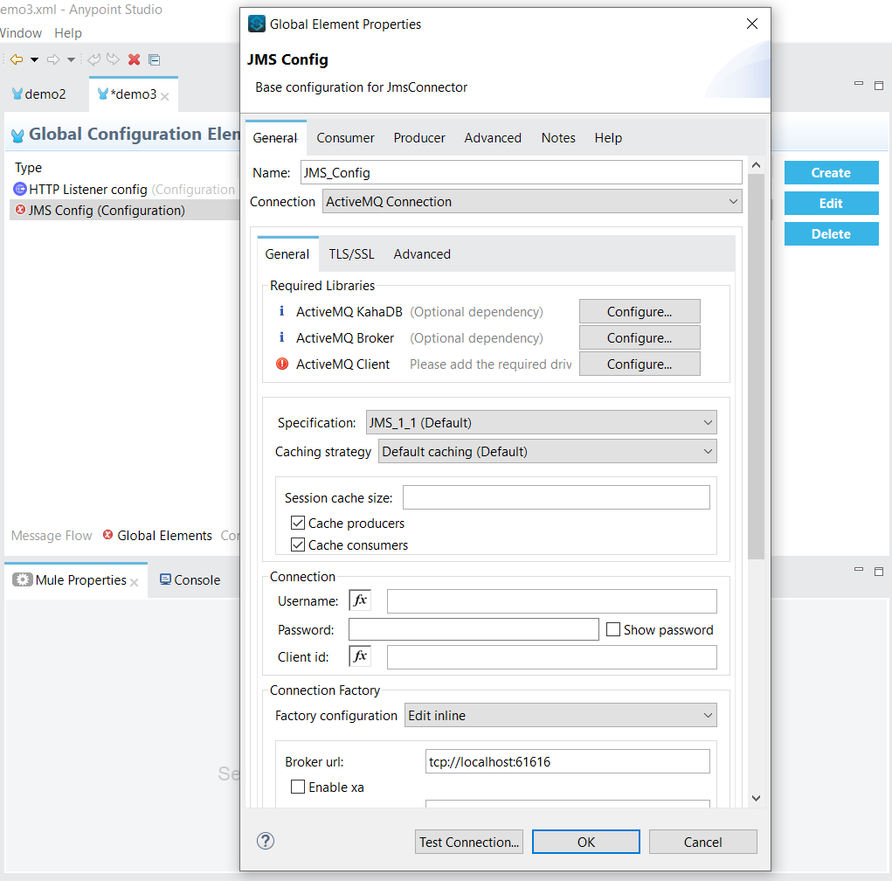
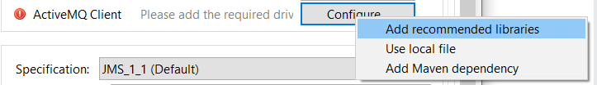
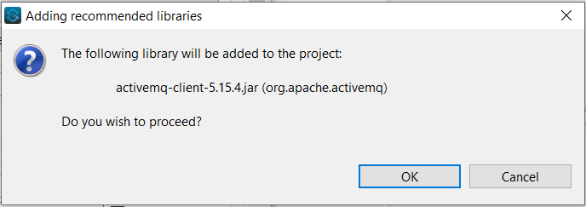
Broker url is ok. Please mind the protocol : tcp. But ActiveMQ Client is missing. Configure it by adding recommended libraries.

Slide 11
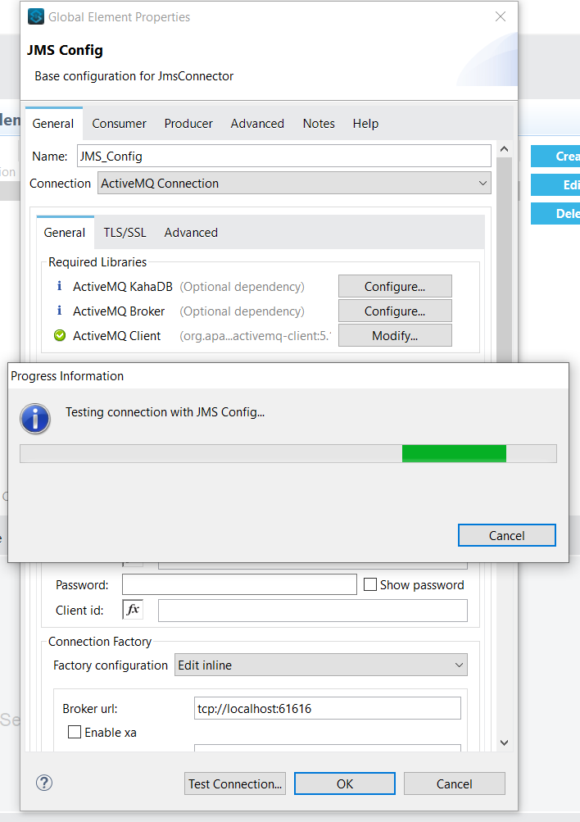
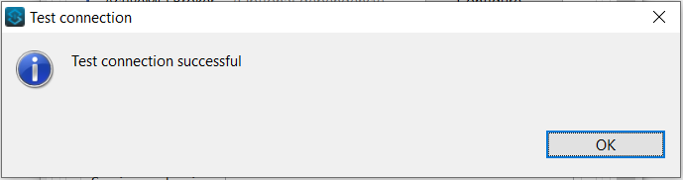
Test connection while ActiveMQ is running.

Slide 12
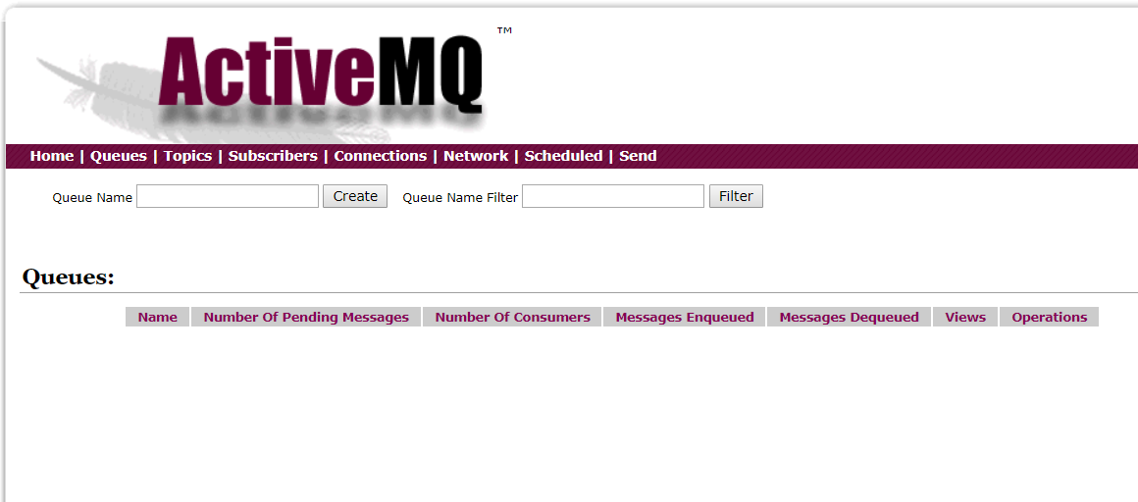
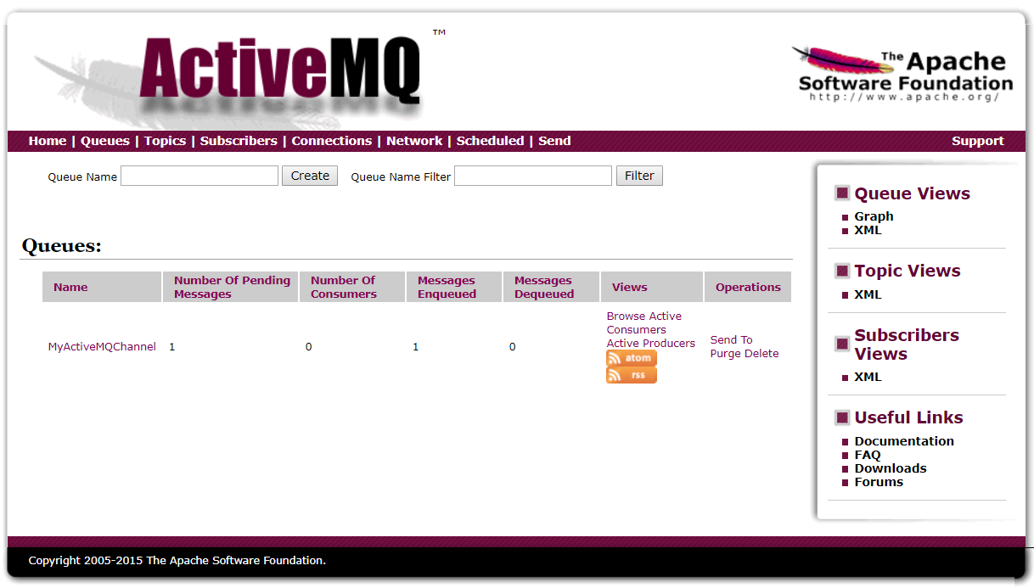
Check the ActiveMQ admin panel. Run your flow in Any Point. Check the panel again.
BINGO!

Slide 13
Next steps
To do : Make a new sub flow in the same Mule Application. This flow should listen to the ActiveMQ Queue by using a JMS Listener. A JMS Listener implicitly consumes a message so you do not have to use the JMS consume component in AnyPoint. Place a Logger component at the end of your flow and place here the payload in the message. The message content should now become visible in console.

